Slide 1
Lecture 17 - Linked Lists & Mutable Trees
Chris Allsman

Slide 2
Announcements
HW4 due Monday 7/29
Proj3 Released
Phase 1 & 2 due Friday
Phase 3 & 4 Due Wednesday, 7/31
Submit 24h early for 1 EC point
MT Grades being finalized
Advising appointment signups @ 3:00 today (see piazza)

Slide 3
Linked Lists

Slide 4
Linked List Definition
A Linked List is either:
Empty
Composed of a first element and the rest of the linked list
Value of first is the number 1
1
2
3
List terminated with an empty linked list
first
rest
first
rest
first
rest
rest contains a pointer to a linked list
Linked lists are sequences where each value is the first element of a pair

Slide 5
Creating Linked Lists
Demo
We’ll define a linked list recursively by making a constructor that takes in a first and rest value
1
2
3
first
rest
first
rest
first
rest
Link(1 , __________________________________)
Link(1 , Link(2, _________________________))
Link(1 , Link(2, Link(3, empty linked list))

Slide 6
The Link Class
class Link: empty = () def __init__(self, first, rest=empty):
assert rest is Link.empty or isinstance(rest, Link)
self.first = first
self.rest = rest
>>> lnk = Link(5, Link(6, Link(7))) >>> lnk.rest.rest.first
7
>>> lnk.rest.rest.rest is Link.empty
True
You should not assume the representation here
Rest defaults to the empty list
.first -> lst[0]
.rest -> lst[1:]
lnk is Link.empty -> not lst
.first gives elements in the list, .rest traverses
Compare to empty list

Slide 7
You Try:
class Link: empty = () def __init__(self, first,
rest=empty):
self.first = first
self.rest = rest
>>> a = Link(1, Link(2, Link(1)))
>>> b = Link(3, Link(2, Link(1)))
>>> combined = Link(a, Link(b))
How would you retrieve the element 3?
combined.rest.first.rest
combined.rest.rest.first
combined.rest.first.first
combined.first.rest.rest
combined.first.rest.first

Slide 8
You Try:
a = Link(1, link(2, link(1)))
1
2
1
b = Link(3, link(2, link(1)))
3
2
1
combined.rest is an arrow to the next link
combined.rest.first is an arrow to b
combined = Link(a, Link(b))
combined.rest.first.first

Slide 9
Processing Linked Lists

Slide 10
Sum
Goal: Given a linked list, lnk, return the sum of all elements in the linked list
1
2
3
6
1
+
5
6

Slide 11
display_link
Goal: Given a linked list, lnk, return a string representing the elements in the linked list
1
2
3
< 1 2 3 >

Slide 12
Map
Goal: Given a linked list, lnk, and a one argument function, f, return a new linked list obtained from applying f to each element of lnk
1
2
3
def map(f, lnk):
“““Your Code Here”””
lambda x: x * 2
2
4
6

Slide 13
Mutating Linked Lists
Demo

Slide 14
Map, V2
Goal: Given a linked list, lnk, and a one argument function, f, mutate the linked list by applying f to each element.
def map(lnk, f):
“““
>>> lnk = Link(1, Link(2, Link(3)))
>>> map(lnk, lambda x: x * 2)
>>> print(display_link(lnk))
<2, 4, 6>
”””

Slide 15
Map, V2
Goal: Given a linked list, lnk, and a one argument function, f, mutate the linked list by applying f to each element.
def map(lnk, f):
if lnk is Link.empty:
return
lnk.first = f(lnk.first)
map(lnk.rest, f)
def map(lnk, f):
while lnk is not Link.empty:
lnk.first = f(lnk.first)
lnk = lnk.rest
1
2
3
1
2
3
2
4
6
2
4
6

Slide 16
Why Linked Lists?
Insert element at index 1
Total number of operations = 1 minus the length of the list
1
3
4
5
6
7
8
9
1
3
4
5
6
7
8
7
8
9
9
1
2
3
4
5
6
7
8
9

Slide 17
Why Linked Lists?
Insert element at index 1
Total number of operations = 2 (Regardless of length of list)
1
3
4
5
6
7
8
2
inserted_elem = Link(2)
inserted_elem.rest = lnk.rest
lnk.rest = inserted_elem

Slide 18
Tree Class

Slide 19
Tree Abstraction
Recursive Description
(wooden trees)
Relative Description
(family trees)
Root
3
Branch
1
2
Nodes
0
1
1
1
Labels
Leaf
0
1
A tree has a root and a list of branches
Each branch is a tree
A tree with zero branches is called a leaf
Each location in a tree is called a node
Each node has a label value
One node can be the parent/child of another

Slide 20
1 class Tree:
2 def __init__(self, label, branches=[]):
5 self.label = label
6 self.branches = branches
3 for b in branches:
4 assert isinstance(b, Tree)
3
7 def is_leaf(self):
2
4
8 return not self.branches
>>> t = Tree(3, [Tree(2, [Tree(5)]), Tree(4)])
>>> t.label
5
3
>>> t.branches[0].label
2
>>> t.branches[1].is_leaf()
Demo
True

Slide 21
Map, V3
Goal: Given a Tree, t, and a one argument function, f, mutate the tree by applying f to each label.
3
6
def map(f, t):
t.label = f(t.label)
for b in t.branches:
map(f, b)
2
4
4
8
t = Tree(3, [Tree(2, [Tree(5)]),
Tree(4)])
map(t, lambda x: x * 2)
5
10

Slide 22
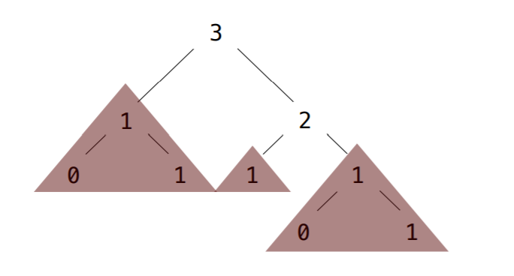
Pruning
Demo
Goal: Given a Tree, t, and a value x, remove each branch with label equal to x
prune(t, 1)

